Slide 1
REPUBLIQUE OF CONGO
OPPORTUNITIES OF INVESTMENT
IN REPUBLIC OF CONGO
PRESENTATION HONOURABLE ISIDORE MVOUBA, MINISTER OF STATE MINISTER OF INDUSTRIAL DEVELOPPEMENT
AND PROMOTION OF PRIVATE SECTOR
10/03/2014
1

Slide 2
COMMUNICATION
I. PROFILE OF REPUBLIC OF CONGO
II. POLITICAL VIEW
IV. OPPORTUNITIES OF INVESTMENTS
V. COOPERATION BETWEEN CONGO AND INDIA
VI. CONCLUSION
10/03/2014
2

Slide 3
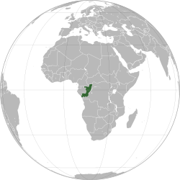
PROFILE OF COUNTRY
OVERVIEW
COUNTRY : République du Congo
CAPITAL : Brazzaville
POPULATION : 4.200.000
AREA : 342.000 Km²
HEAD OF STATE: Denis SASSOU NGUESSO
YOUNG POPULATION : 51%
OFFICIAL LANGUAGE: French
10/03/2014
3

Slide 4
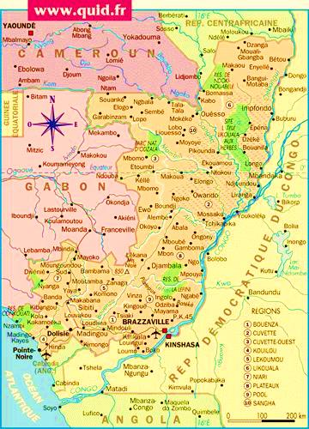
IDE: $352 millions
Exportation: $ 5037 millions dont $4375 millions de pétrole et $403 millions de bois
Importations: $ 1564 millions
PAYS FRONTALIERS
GABON,
CAMEROUN,
RÉPUBLIQUE CENTRAFRICAINE,
RÉPUBLIQUE DÉMOCRATIQUE DU CONGO,
ANGOLA
10/03/2014
4

Slide 5
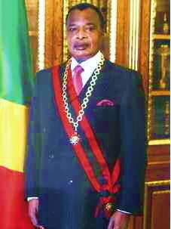
POLITICAL SITUATION
Since 2002, the Republic of Congo has a political and institutional stability based on a constant quest for social and political consensus. This stability is an important asset for the economic development of the country that acceded in 2010 to the completion point of the Heavily Indebted Poor Countries (HIPC) initiative.
The society project of the President of Republic « The Path of Future », and the National Development Plan which the Government program give a specific place to modernization and industrialization for boosting economical diversification policy.
10/03/2014
Denis SASSOU NGUESSO
Président de la République
5

Slide 6
POLICY OF DEVELOPMENT
ISSUES
Diversify and accelerate growth for:
Out of the dependence on the oil sector that contributes to GDP of 64%.
Create jobs and develop the social sector to the extent of the Millennium Development Goals (MDGs)
And the ambitions of the emergence of the Congo and aspirations of the Congolese

Slide 7
POLICY OF DEVELOPMENT
MODERNIZATION
INDUSTRIALIZATION
National Development Plan
GROWTH
DIVERSIFICATION
THROUGH CLUSTERS
POLICY
THE PATH FOR FUTURE
HOUSING
CONSTRUCTIONMATERIALS
OIL
HYDROCARBON
FINANCIAL
SERVICES
MINING
AGRICULTURE AGRO INDUSTRY
FORET ET INDUSTRIE DU BOIS
TOURISM AND HOSPITALITY

Slide 8
POLITIQUE DE DEVELOPPEMENT
PRIVATE SECTOR ENGINE OF GROWTH
PROMOTION OF
PRIVATE SECTOR
- INDUSTRIALIZATION
DIVERSIFICATION
MODERNIZATION

Slide 9
INDUSTRIALIZATION STRATEGY
THREE STRATEGIC INTERVENTION OPTIONS
Declined in the letter of industrialization policy prescribed by the Congo President of the Republic
PRINCIPAL OBJECTIVES:GETTING CONGO THE STAGE OF "PRIMARY PRODUCER« TO THAT OF PRODUCER OF GOODS MANUFACTURED
I.
FOOD SECURITY
II. ENHANCING QUALITY OF LIFE AND HOUSING
III.
SUPPORT ALL INITIATIVES OF CREATION INDUSTRIES
10/03/2014
9

Slide 10
STRATEGIE D’INDUSTRIALISATION
GLOBAL OBJECTIVE
CONTRIBUTE TO ECONOMIC GROWTH AND THE FIGHT AGAINST POVERTY
INCREASE VOLUME OF PRIVATE AND PUBLIC INVESTMENTS IN INDUSTRY SECTOR;
CREATE AND PLANT INDUSTRIES IN ORDER TO CREATE SYNERGIES AROUND OTHERS OTHER INDUSTRIES UPSTREAM AND DOWNSTREAM SECTORS;
CREATE THE CONDITIONS OF EMERGENCE AND DEVELOPMENT OF POLES OF GROWTH AND COMPETITIVENESS;
CREATE INDUSTRIAL ZONES
INCREASE THE SHARE OF INDUSTRY IN GDP
SPECIFIC OBJECTIVES
10/03/2014
10

Slide 11
INDICATORS
GDP BY SECTORS (2010)
10/03/2014
11

Slide 12
INDICATORS
SHARE OF CONTRIBUTION OF PRIVATE SECTOR IN GDP
THE PRIVATE SECTOR SHARE (EXCLUDING OIL) IS ON AVERAGE 5% OF THE GROSS NATIONAL PRODUCT OF THE CONGO. THIS RATE IS 14% IN AFRICA AND 25% IN ASIA.
10/03/2014
12

Slide 13
OPPORTUNITIES OF INVESTMENT
WHY INVEST IN REPUBLIC OF CONGO?
POLITICAL AND INSTITUTIONAL STABILITY
CONTEXT MACROECONOMIC STABILITY
LEGISLATIVE AND REGULATORY FRAMEWORK AND INCENTIVE WITH A PROTECTION POLICY, GUARANTEE AND INVESTMENT PROMOTION
LEGAL AND JUDICIAL ENVIRONMENT FAVORABLE BACKED BUSINESS LAW COMPLIES WITH THE ORGANIZATION FOR THE HARMONIZATION OF BUSINESS LAW IN AFRICA (OHADA)
ENORMOUS ECONOMIC POTENTIAL AND UNDERUTILIZED IN THE AREAS OF AGRIBUSINESS AND AGRICULTURE, INDUSTRY, MINING, TOURISM, OIL, WOOD INDUSTRY, SERVICES, ETC.
A YOUNG, DYNAMIC, ENTREPRENEURIAL POPULATION
10/03/2014
13

Slide 14
OPPORTUNITIES OF INVESTMENT
WHY INVEST IN REPUBLIC OF CONGO?
7. A zone of monetary stability with a common currency in the CEMAC zone. ECCAS member countries CACEU, MIGA, CIMA, OAPI, the ACP
8. A strategic position in the heart of Central Africa is the Congo a country of transit. Its sub-regional integration gives access to a market of almost 120 million consumers.
9. One of the largest deepwater seaport connected to the river port by a railway whose rehabilitation is initiated.
10. A varied notably with the construction of the motorway and road network Pointe-Noire/Brazzaville completion pathways relay between Congo and neighboring countries such as Gabon, Cameroon, the Central African Republic. To this is added the road-rail bridge between Brazzaville and Kinshasa (DRC).
11. A diversified and modernized airport network
10/03/2014
14

Slide 15
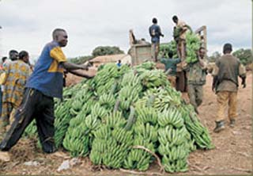
OPPORTUNITIES OF INVESTMENTS
CLUSTER AGRICULTURE AND AGRO INDUSTRY
AGRICULTURE
Farmland representing 8.2 million ha, or
25% of the land area of which 2% are
exploited.
FISHING
The country has an exclusive economic zone of
60,000 km2, 170 km of coastline and a
continental shelf of 10,000 km2
Opportunities
Corn processing to solve the thorny problem of livestock feed and other
Processing cassava starch and other
Fish processing
Processing fruit products
10/03/2014
15

Slide 16
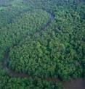
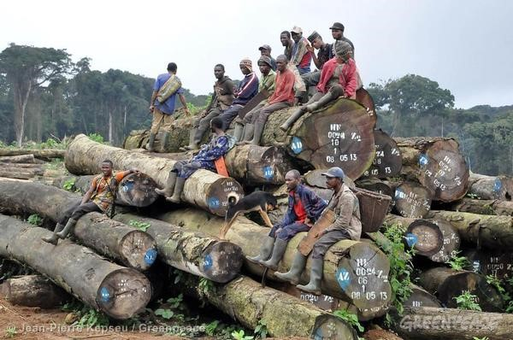
OPPORTUNITIES OF INVESTMENTS
CLUSTER FOREST ET INDUSTRY OF WOOD
Forests cover 22.2 million hectares of land is 65% of the national territory. Solid second in the Congo Basin forests with a rich biodiversity of more than 10,000 species of fauna and flora. It plays a major role in the fight against global warming and the destruction of the ecosystem.
FOREST INDUSTRY
Potential timber production: 2 million m3 per year. Opportunities -Production of pulp; -Further wood processing at the local level, (the Forest Code liberalizing logging and requires to transform 85% of wood in the country to create added value.
SPECIES RICH:
MAHOGANY,OKOUME,
LIMBA , SAPELLI
SIPO, BAHIA, EUCALYPTUS
10/03/2014
16

Slide 17
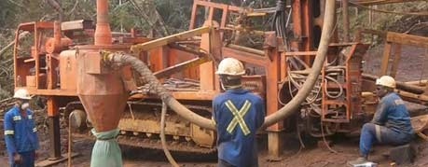
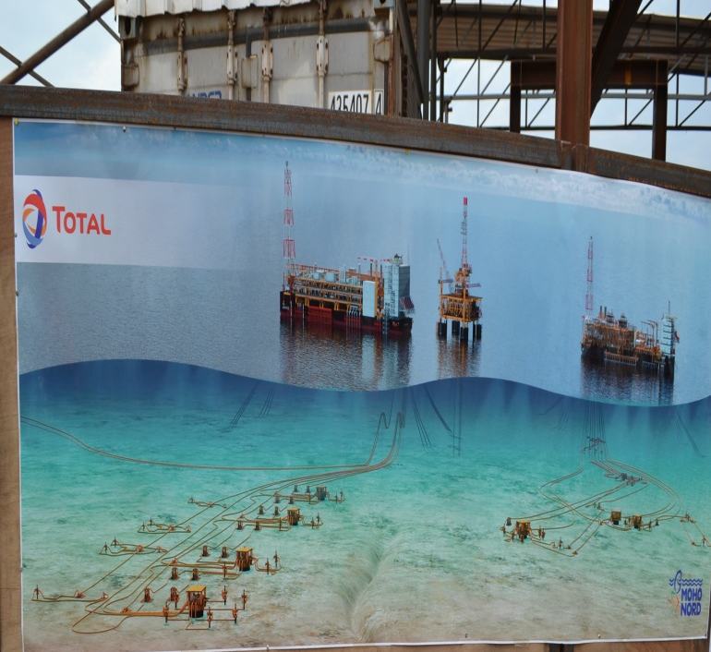
OPPORTUNITIES OF INVESTMENTS
CLUSTER OIL AND HYDROCARBONS
OPPORTUNITIES
Recovery of associated gas and natural gas for industrial, agricultural and domestic, including: Production of methanol Production of butane and propane The production of chemical fertilizers Other opportunities with oil: Road bitumen production; Manufacture of plastics; Production and distribution of lubricants and other chemical products pro.

Slide 18
OPPORTUNITIES OF INVESTMENTS
CLUSTER MINING AND MINERALS
MINES Abundant mineral resources including: Iron, polymetals, Potassium Phosphate, Limestone, Zinc, Uranium, Diamond, Gold and Natural Gas. BUSINESS OPPORTUNITIES
Mayoko iron mining in the department of Niari, iron Zanaga in the department Lékoumou
Diamond mining
Installing industries producing metal profiles
10/03/2014
18

Slide 19
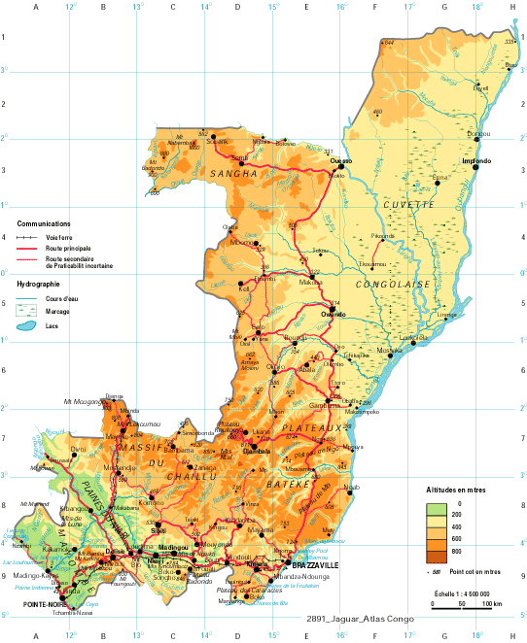
OPPORTUNITIES OF INVESTMENTS
HYDROGRAPHY
An intertropical climate appropriate to agriculture. Hydrography pegged to the 2nd most powerful river in the world.
10/03/2014
19

Slide 20
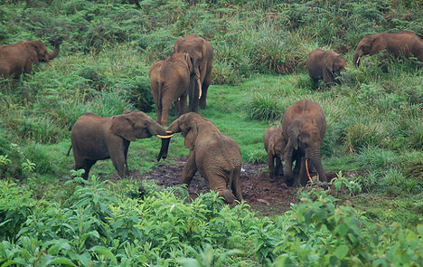
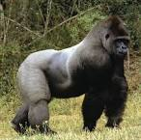
OPPORTUNITIES OF INVESTMENTS
TOURISM AND HOSPITALITY
TOURISM
Congo has many sites of tourist interest and undeniable that the development would contribute to the diversification of tourism products including:
OPPORTUNITIES Valorization of Natural parks and
Protected Areas
Organization of Hunting /hiking Seasons
Business Tourism
10/03/2014
20

Slide 21
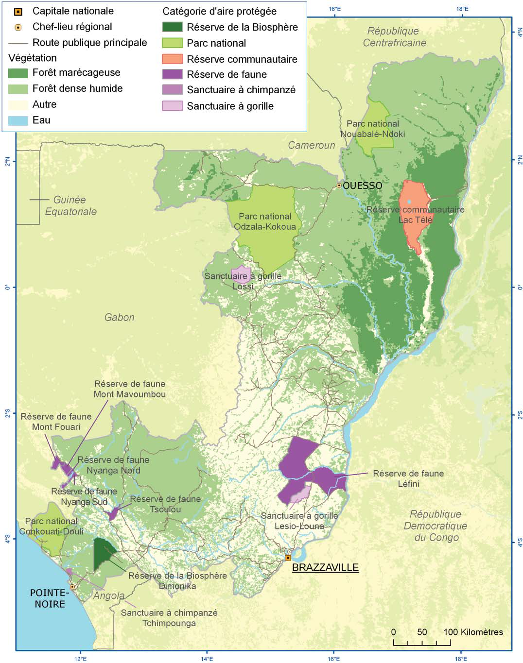
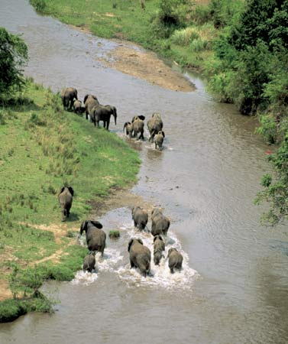
OPPORTUNITIES OF INVESTMENTS
CLUSTER INDUSTRY OF TOURISM

Slide 22
OPPORTUNITIES OF INVESTMENTS
OTHERS SECTORS
Other activities are also potential generators of jobs, including: - Transport (land that allowed the unification of the country). - The Information Technology and Communication (ICT). The digital divide will soon be a memory with the program of national broadband coverage (broadband). - Infrastructures
10/03/2014
22

Slide 23
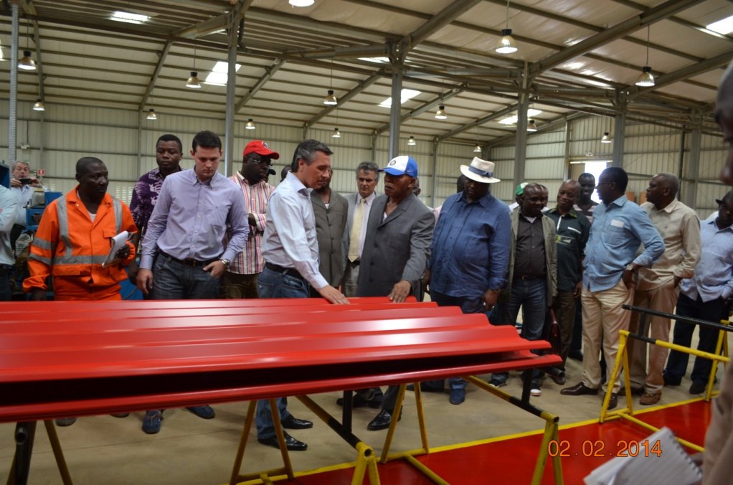
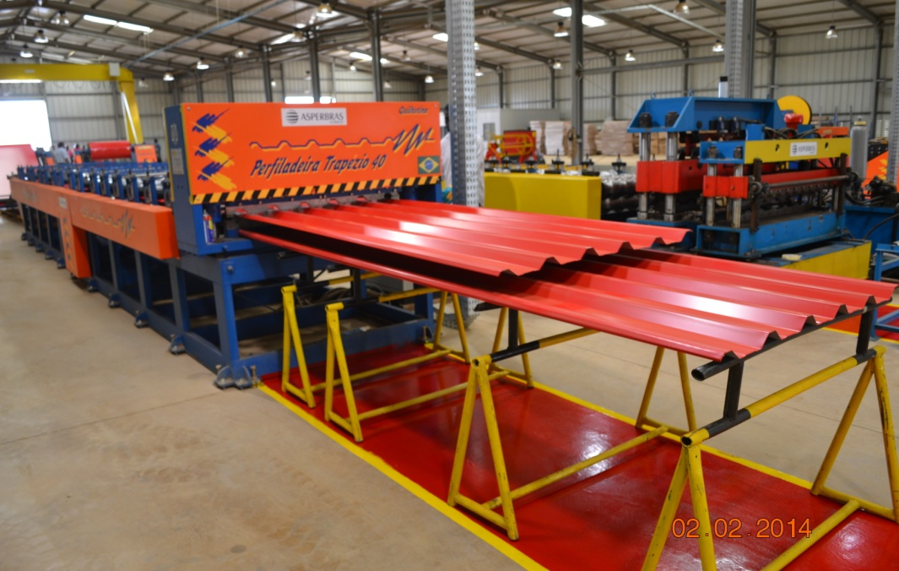
OPPORTUNITIES OF INVESTMENTS
INDUSTRIAL AREA OF MALOUKOU
The Congolese Government has
Created the first industrial zone
about 80 km from Brazzaville. This
Include area near a twenty
industries for most specialized in
Building materials (sheets, tanks,
PVC pipe, etc.. Business Opportunities
Establishment of joint ventures with private
management of these industrial units.
10/03/2014
23

Slide 24
OPPORTUNITES D’INVESTISSEMENTS
IMPROVING COMPETITIVENESS AND ATTRACTIVE COUNTRY
To boost the private sector and attract private investment flows and FDI, reforms have been undertaken, some others are in progress, by way of assistance and support to the sector. They relate in particular to the following aspects:
- Entrepreneurship (creating single window CFE; introduction of a single tax, the price varies depending on the type of company) - Obtaining building permits, electricity connection
- Transfer of ownership
- Payment of taxes (abolition of all taxes and non statutory taxes) - Border trade (setting up a maritime stop)
- Obtaining loans
- Investor protection
- Enforcing Contracts
- Regulation of insolvency
- Employing Workers
10/03/2014
24

Slide 25
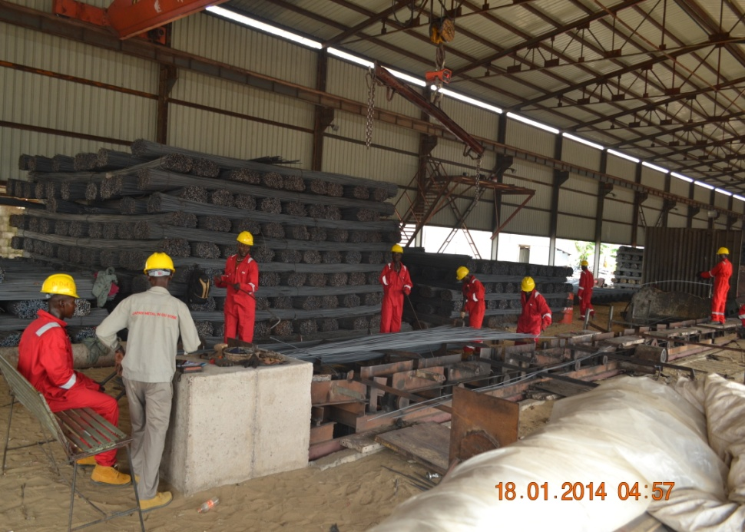
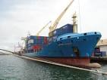
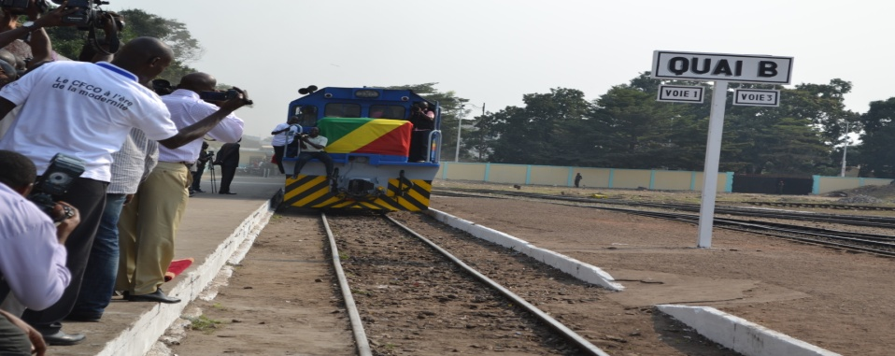
OPPORTUNITIES OF INVESTMENTS
IMPROVING COMPETITIVENESS AND ATTRACTIVE COUNTRY
PORT DE POINTE-NOIRE
10/03/2014
BARRAGE D’IMBOULOU
25

Slide 26
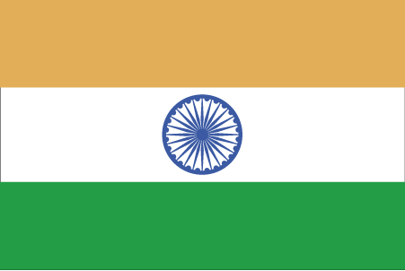
IV. BILATERAL COOPERATION (INDIA - CONGO)
Bilateral relations between India and the Congo are in good shape . The foundations for a fruitful cooperation arose. The next visit to India of HE Denis Sassou Nguesso , President of the Republic mark the seal of this bilateral relationship.
Under the CII Exim Bank Conclave between Congo and India, the rural electrification projects in the Congo, Improved urban transport system in Brazzaville and Pointe -Noire, and the laboratory quality control food , have made ​​progress . Projects approved in the Forum India - Africa Partnership focus on the Pan-African telecommunications network services (telemedicine , teleducation, diplomatic communications). I must say that the President of the Republic following with great attention the progress of the implementation of all these projects. The list of projects is likely to lie in relation to areas where CII intends to establish bilateral partnerships with financial support from Exim Bank and other Indian financial structures. Financing of overseas joint ventures will be a rewarding experience to raise the local content which is taking place in our country.
10/03/2014
26

Slide 27
V. CONCLUSION
In summary, we cling heavily to the efforts that the Government agrees in improving the business climate and conditionalities base that secures both domestic and foreign investment through appropriate incentives and institutional framework capable to exert a strong appeal to our country with the key to the accompanying support and support structures such as: The High Council of Public-Private Dialogue
The Agency for Investment Promotion
Special Economic Zones
10/03/2014
27

Slide 28
THANK YOU FOR YOUR KIND ATTENTION
10/03/2014
28

